Slide 1
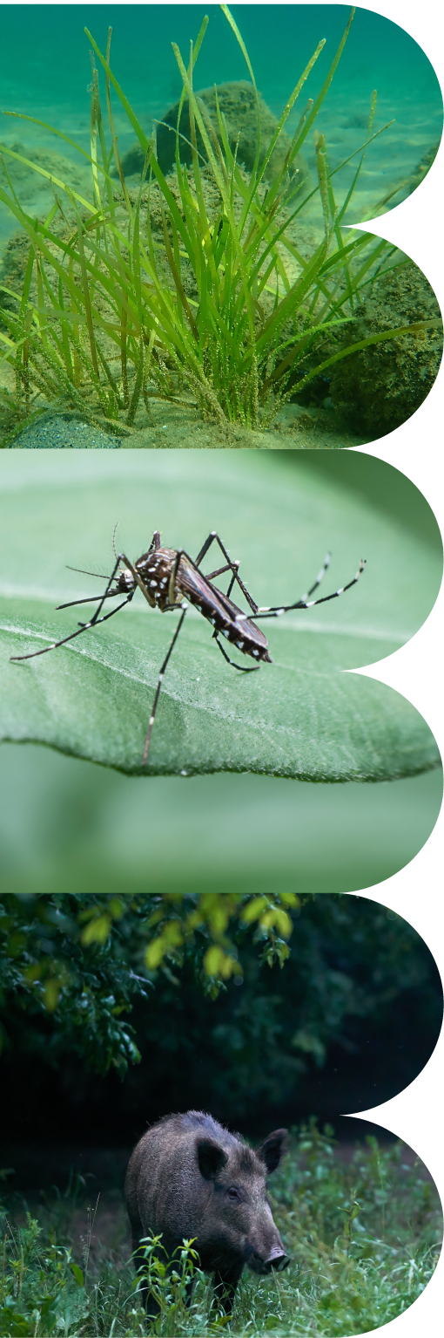



Empowering Biodiversity Monitoring through Data Cubes
Techniques & Applications for Open Science
Maarten Trekels & Sandra MacFadyen
2, 9, 16, 23 Oct 2024
Online
NITheCS mini-school

Slide 2
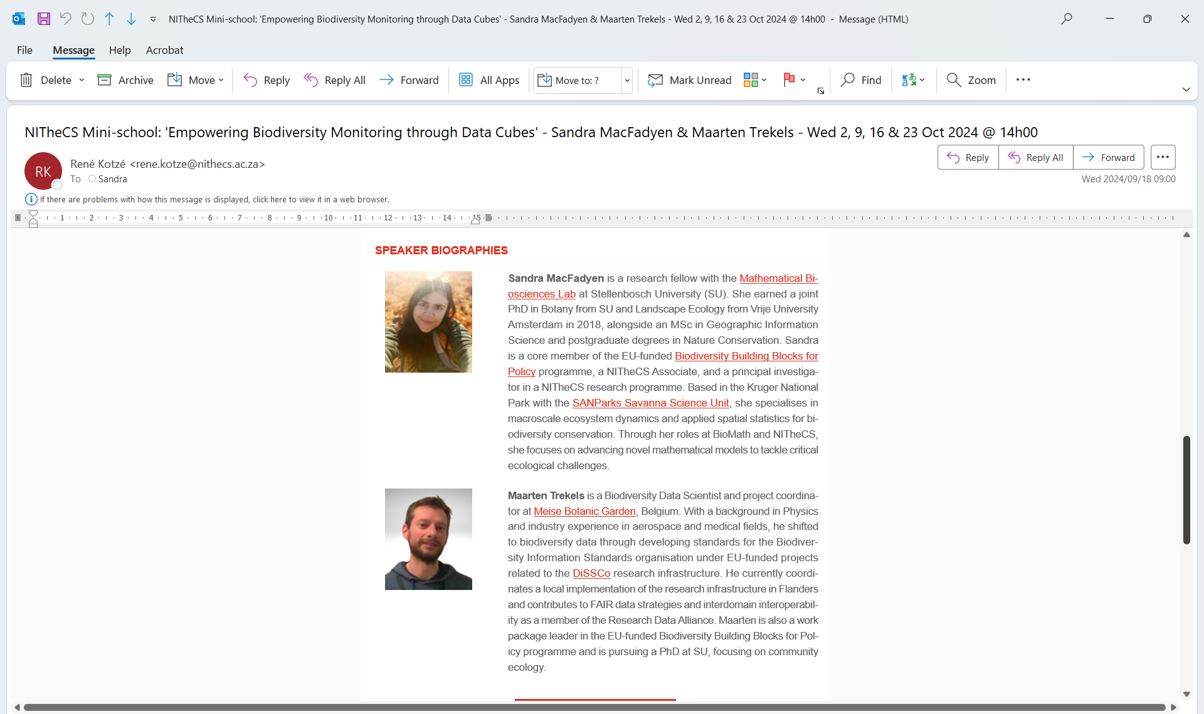
Introductions
Biodiversity Monitoring and Data Cubes
Who are we
Online: Wednesdays - 2, 9, 16 & 23 October 2024 @ 14h00-15h00 SAST

Slide 3
Biodiversity Monitoring using Data Cubes
Techniques and Applications for Open Science
Mini-school Outline
Online: Wednesdays - 2, 9, 16 & 23 October 2024 @ 14h00-15h00 SAST
Session 1: Introduction (Sandra and Maarten)
  A general introduction to Biodiversity and Data Cubes
  Sources of Biodiversity Data and Data Standards
  Data publication and FAIR data publishing
  Homework - List of free accounts to setup before next, more hands-on, sessions
Session 2: Building Data Cubes with GBIF (Maarten)
  Introduction to GBIF data
  A Hands-On Guide for Biodiversity Monitoring
Session 3: Ecological Modelling with Data Cubes (Sandra)
  Create your own Data Cube using GBIF, Google Colab and Earth Engine
  Visualise results on a interactive map
  Analyse patterns of species diversity related to environmental variables, like climate
Session 4: Open Science (Maarten and Sandra)
  Sharing and Disseminating Results
  Hands-on with Github and Zenodo
  Mini-school Wrap Up and inputs from you - What topics to explore in our next mini-school?

Slide 4
LECTURE 1: INTRODUCTION
An Introduction to Biodiversity and Biodiversity Data Cubes
Sandra MacFadyen & Maarten Trekels
02 October 2024
Online
NITheCS mini-school

Slide 5
What is Biodiversity
Variety of all living things and their interactions

Slide 6
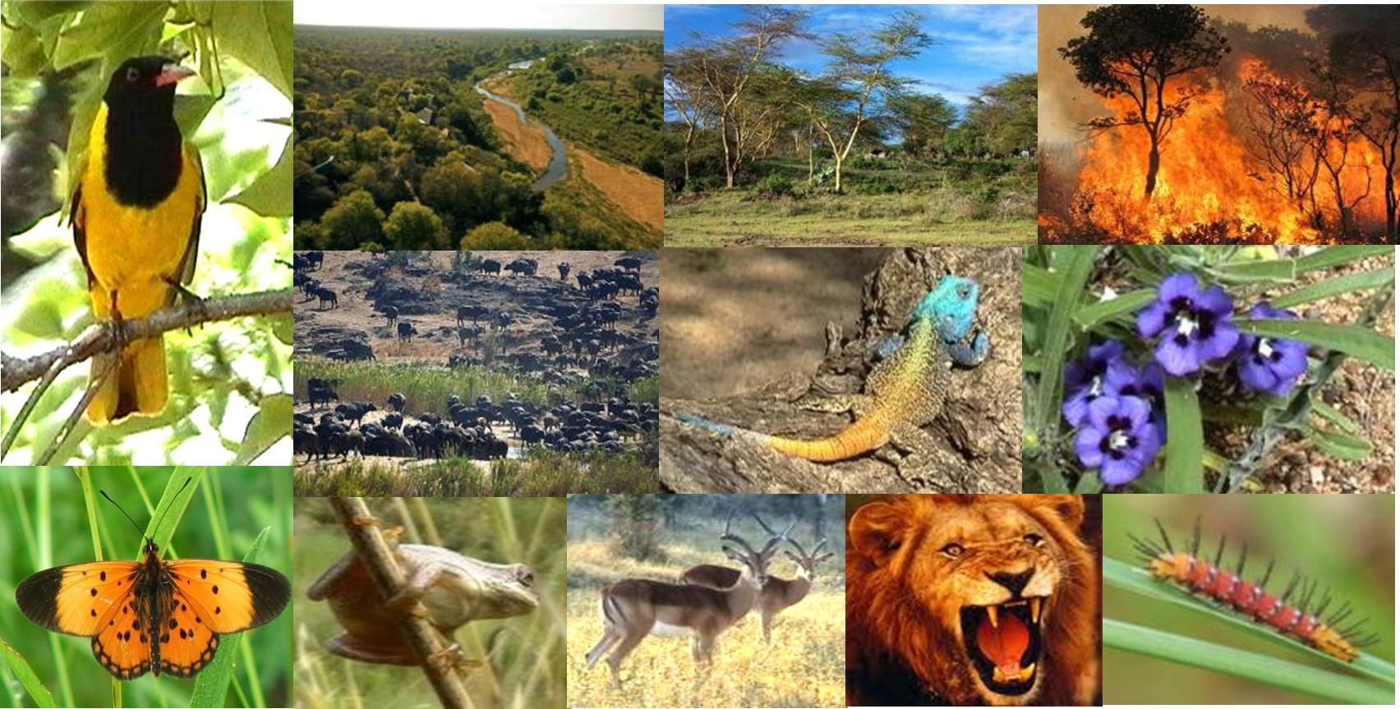
Biodiversity
Biodiversity is the variety of all living things and their interactions
Not just diversity of species
Biodiversity, or biological diversity, is the variety of life on earth.
It includes all the ways these living organisms interact with each other and their environment.

Slide 7
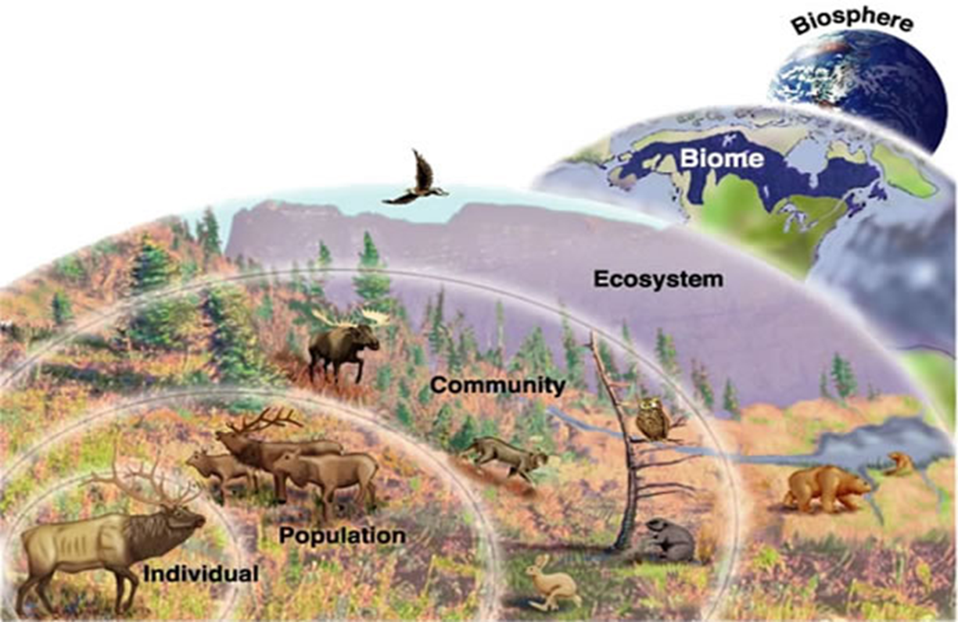

Biodiversity
Biodiversity is the variety of all living things and their interactions
Different Scales of Biodiversity
Genetic Diversity: Variation in genes within species, allowing for adaptability and resilience.
Species Diversity: Variety of species within an ecosystem or across the planet.
Ecosystem Diversity: Variety of ecosystems (forests, oceans, grasslands, etc.) that provide different habitats and services.

Slide 8
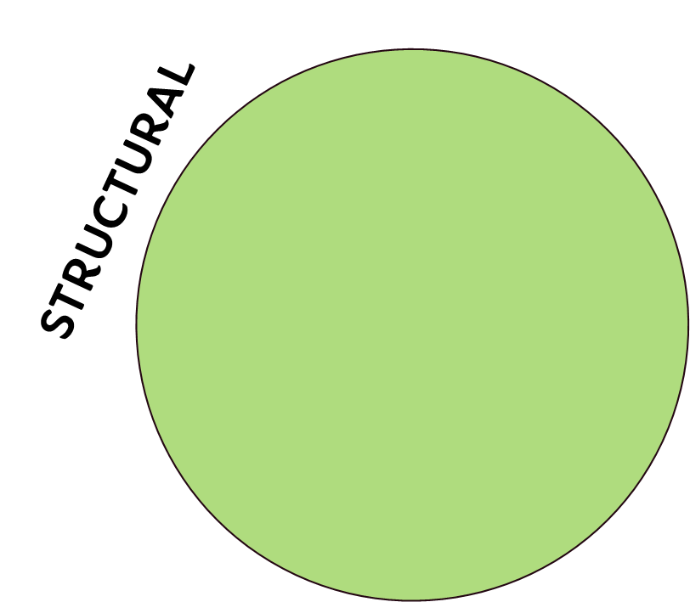
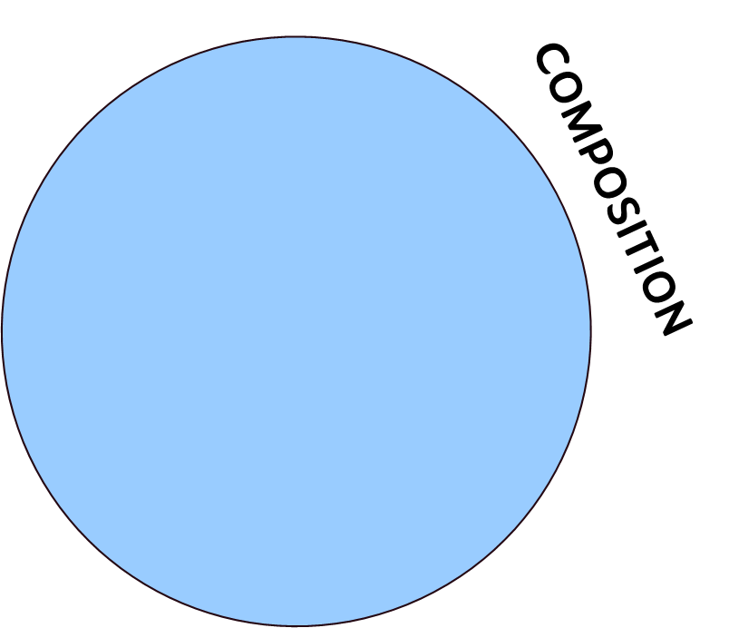
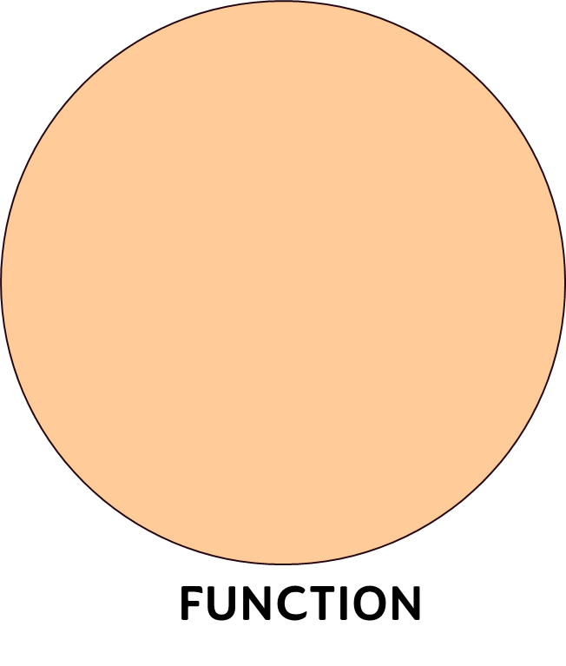
Biodiversity
Biodiversity is the variety of all living things and their interactions
Different Components of Biodiversity
Composition: Identity and variety of species, genes, and ecosystems in a given area. Includes species richness and genetic diversity within species.
Structure: Physical organization or pattern of biodiversity, including the spatial distribution and abundance of species within ecosystems. As well as the arrangement of ecosystems across landscapes.
Function: Ecological processes and roles that species, genes, and ecosystems play in maintaining ecosystem health and services. Includes nutrient cycling, energy flow, and species interactions (e.g. predation, pollination, etc.).

Slide 9
STRUCTURAL
COMPOSITION
Landscape
patterns
Landscape
types
Ecosystem/Habitat
structure
Ecosystems
Communities
Population
structure
Populations
Species
Genetic
structure
Genes
Genetic
processes
Population
dynamics
Interspecific
interactions
Landscape
processes
FUNCTION
adapted from NOSS 1990 and Nigmann et al 2009

Slide 10
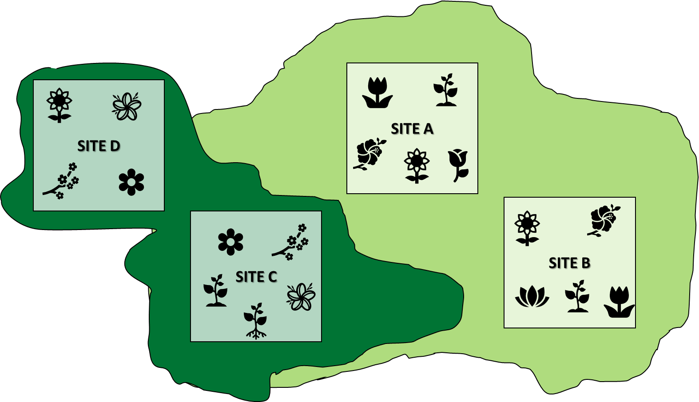
Biodiversity
Biodiversity is the variety of all living things and their interactions
Different Measures of Biodiversity
Alpha Diversity: Variety of species within a single site/ecosystem
ZETA ζ
ALPHA α
BETA β
Gamma Diversity: Total species variety across all sites/ecosystems in a landscape
Beta Diversity: Difference in species composition between two sites/ecosystems
Zeta Diversity: Number of species shared by any number of sites /ecosystems
GAMMA γ

Slide 11
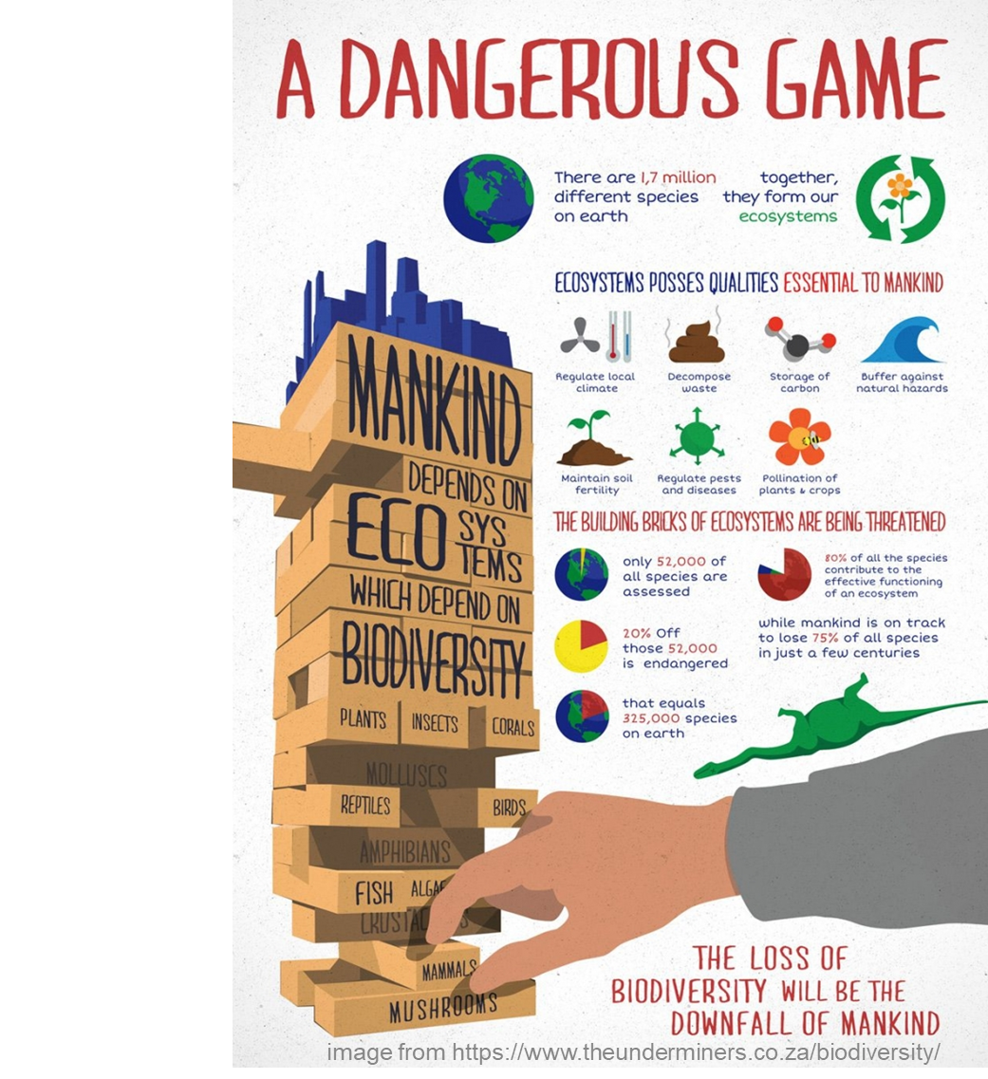
Biodiversity
Biodiversity is the variety of all living things and their interactions
Why care?
Provides and supports important natural functions or ecosystem services
  Support natural processes (e.g. nutrient cycling)
  Resource provision (e.g. food, water)
  Regulate systems (e.g. natural disasters)
  Cultural benefits (e.g. aesthetic, recreational)
Biodiversity loss = threat to ecosystem health, services they provide & human well-being

Slide 12
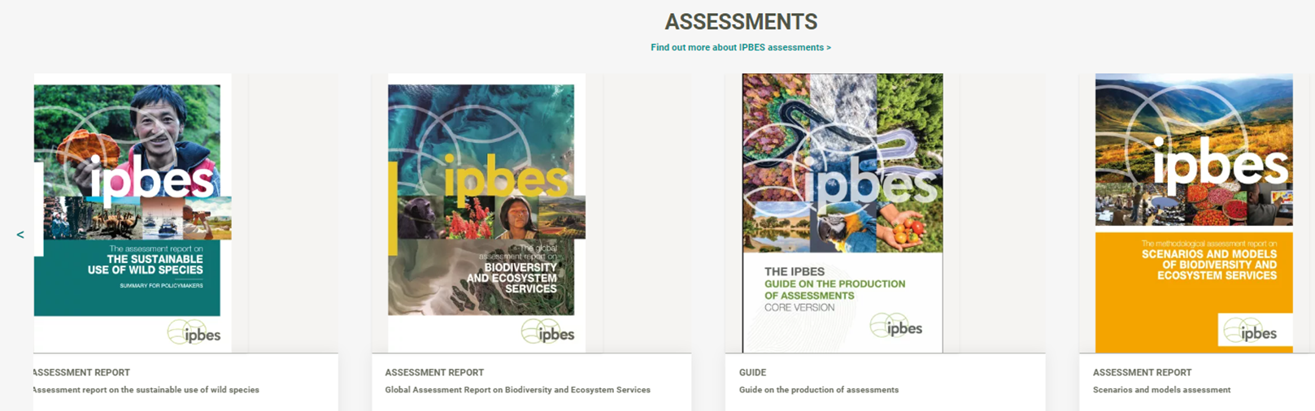
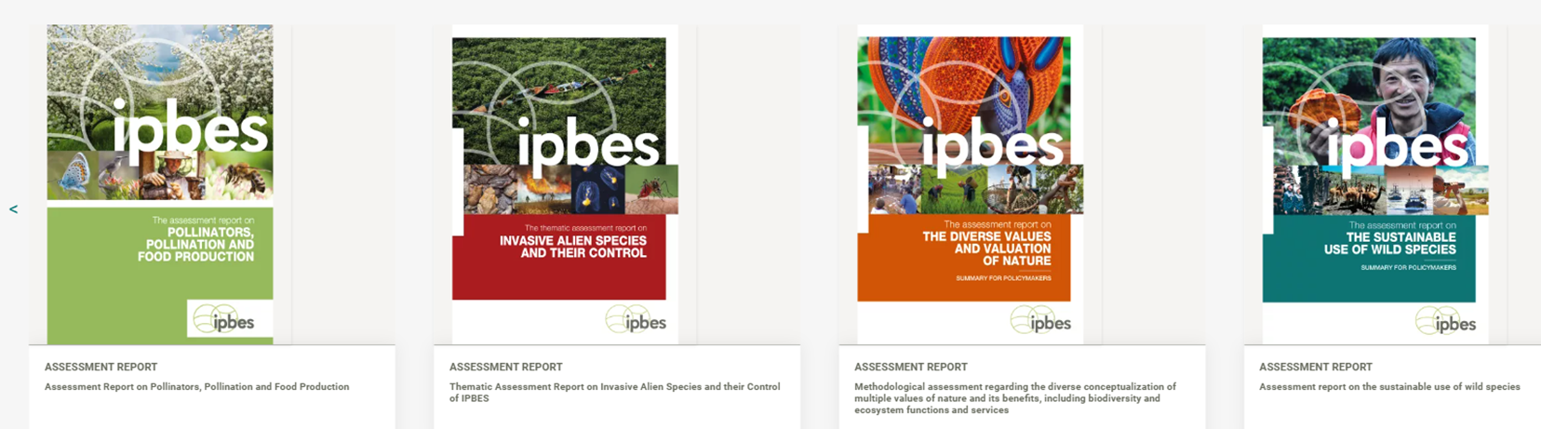
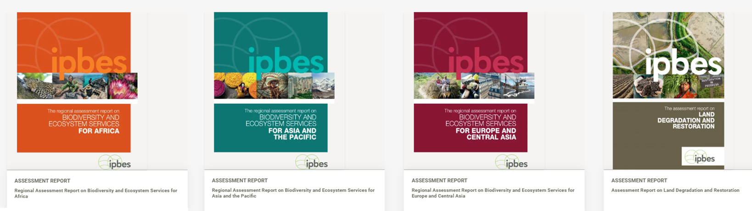
Biodiversity
Biodiversity is the variety of all living things and their interactions
Biodiversity in crisis

Slide 13


Slide 14
The Role of Data Cubes in Biodiversity Monitoring
Bridging Biodiversity and Technology
Global crisis needs global solutions
Biodiversity is the foundation of ecosystem health.
Global threats like habitat loss and climate change make monitoring biodiversity at relevant scales increasingly critical.
To respond to the global crisis we need global/standardised solutions.
Data cubes offer a scalable approach to measuring biodiversity change across components and scales.
Throughout this mini-school, we’ll explore how data cubes can enhance biodiversity monitoring and support global conservation efforts.
But first - What is a Data Cube?

Slide 15
Introduction to Data Cubes Fundamentals and Applications

Slide 16
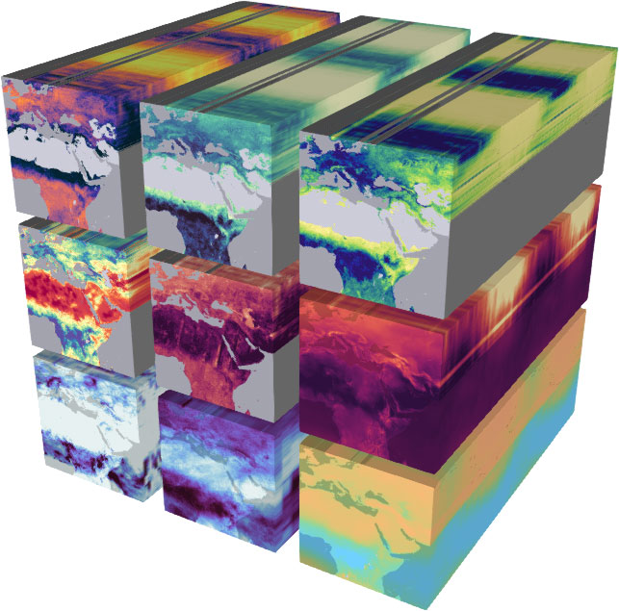
Introduction to Data Cubes
Multidimensional arrays of data, used for spatiotemporal analysis
What are Data Cubes?
Data cubes are multi-dimensional arrays of data, used for spatiotemporal analysis.
Dimensions and structure cubes:
  Time
  Space
  Variables
https://doi.org/10.5194/esd-11-201-2020

Slide 17
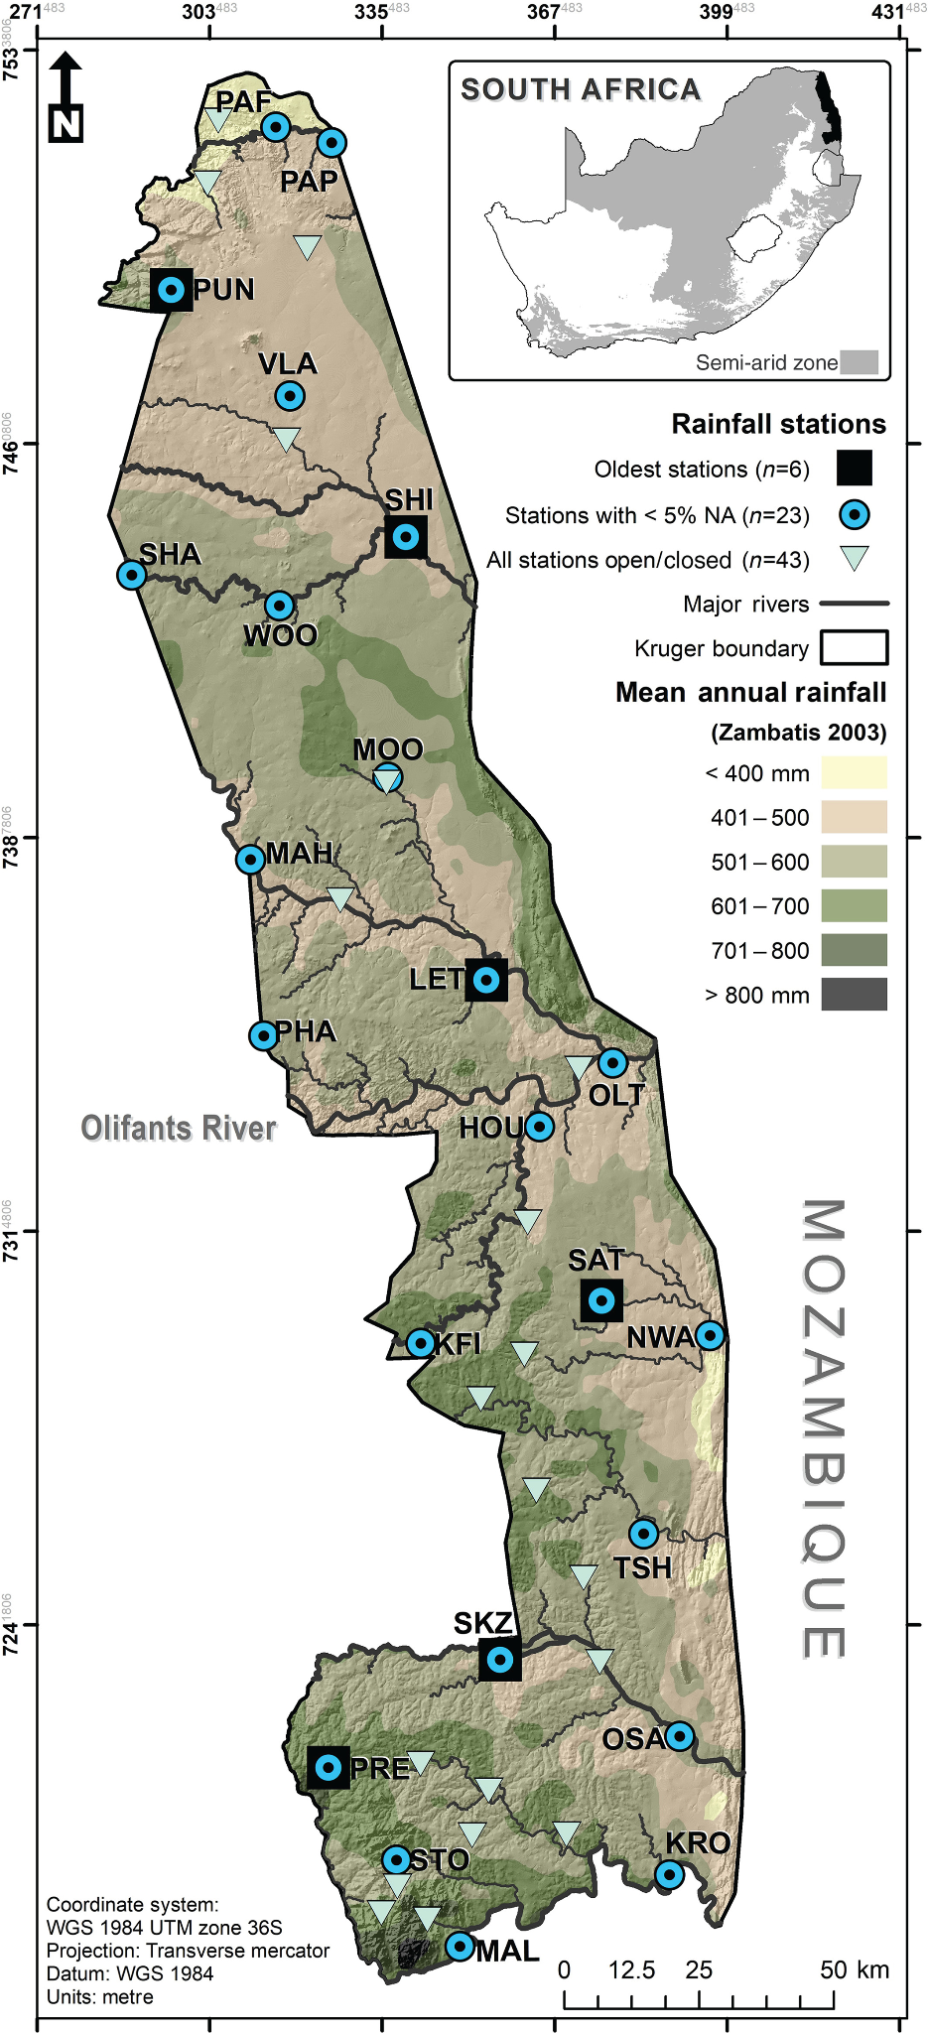
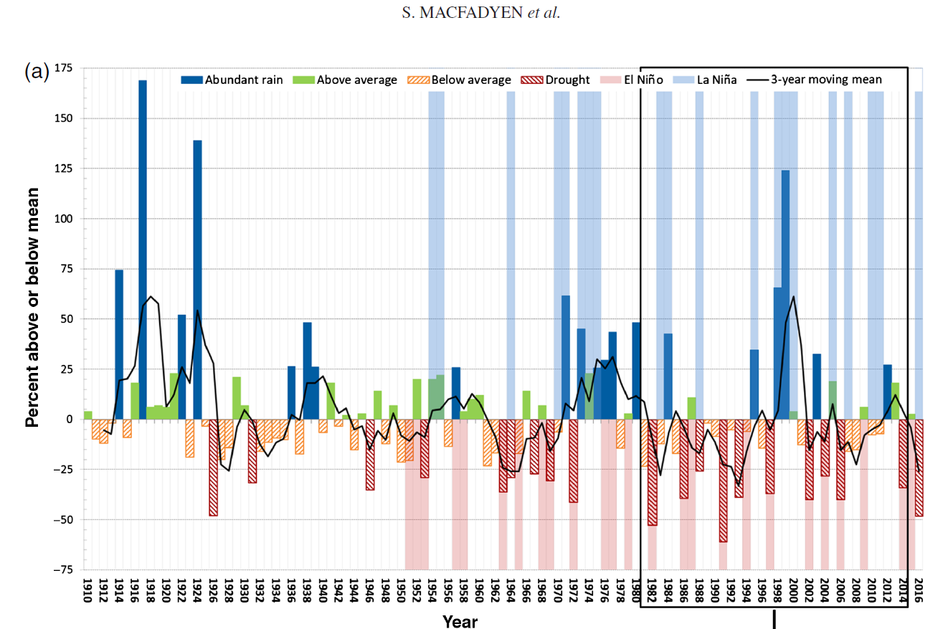
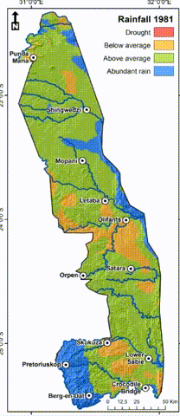
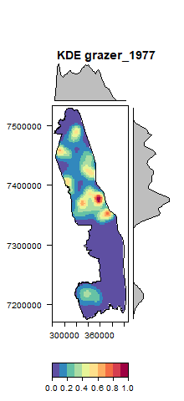
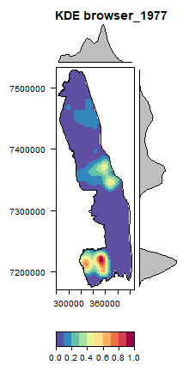
Introduction to Data Cubes
Time - Space - Variables
Dimensions of Data Cubes
Time
Space
Variables

Slide 18
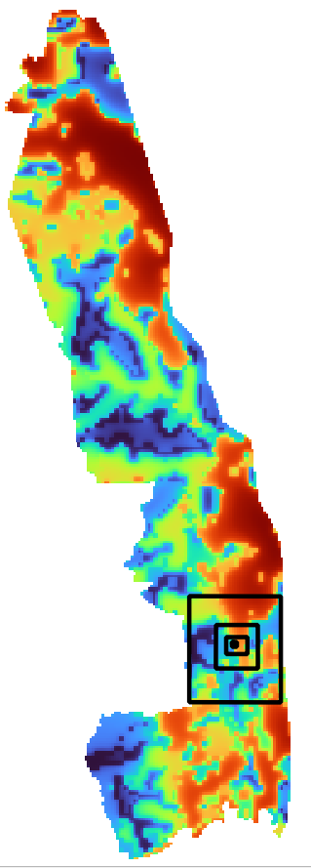
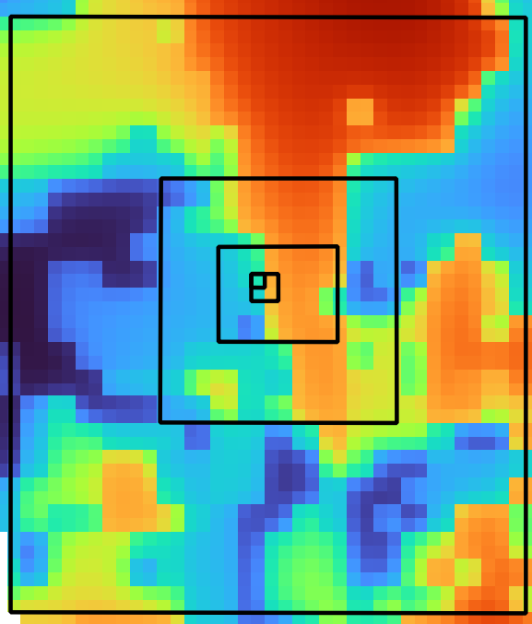
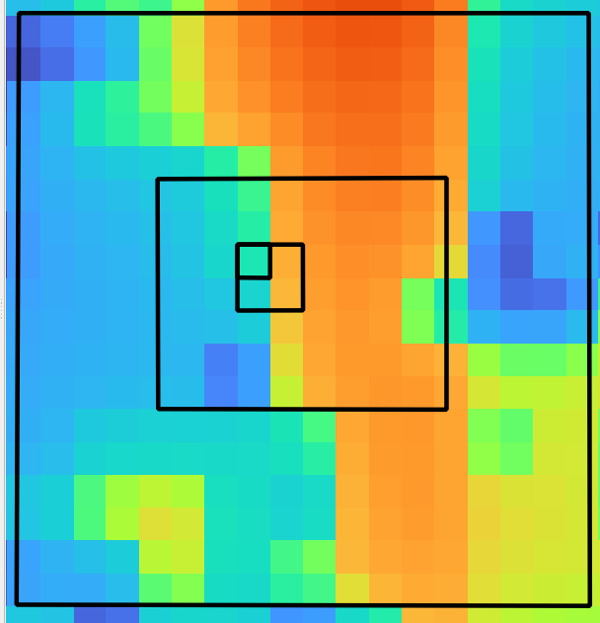
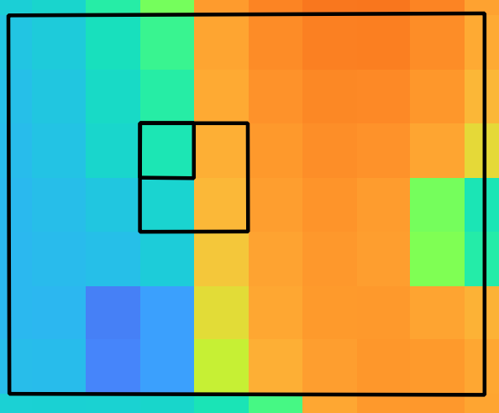
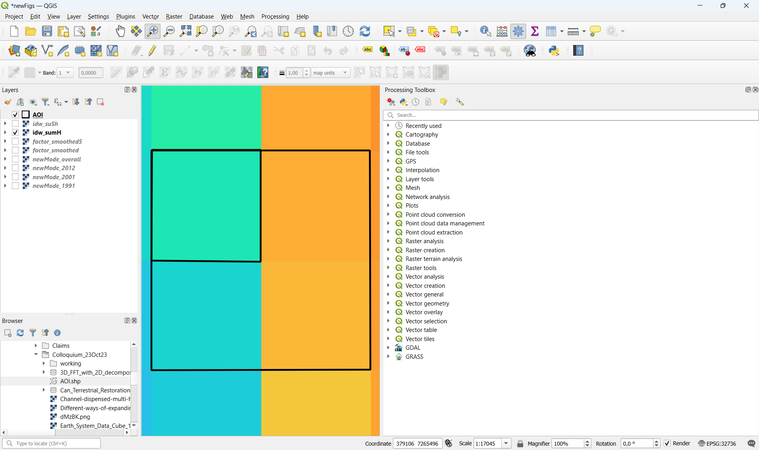
Introduction to Data Cubes
Time - Space - Variables
Variability across scales
TIME
sss
1 Year
1 Mnth
1 Day
1 Hour
SPACE

Slide 19
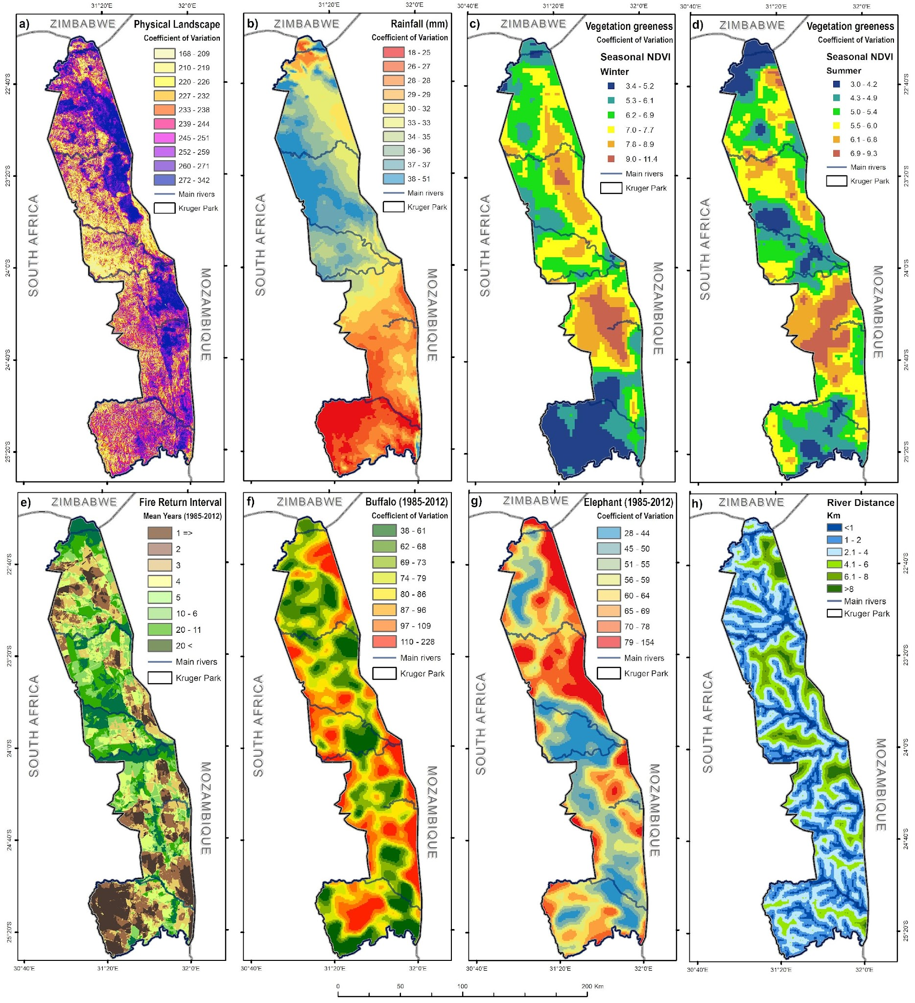
Introduction to Data Cubes
Variables in the context of Biodiversity
Complexity of ecosystems + variability across scales
Account for interactions between genes, species, communities, and their environments, adding complexity across time and space.
Data cubes can represent a variable over time, across space.
Combining variables into multi-dimensional matrices allows us to also track interactions ⇆ dynamics and environmental changes.

Slide 20
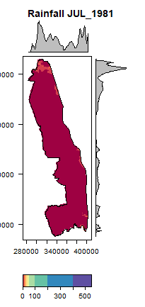
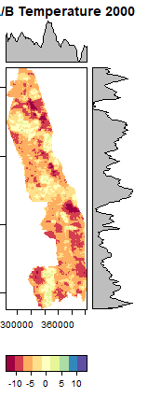
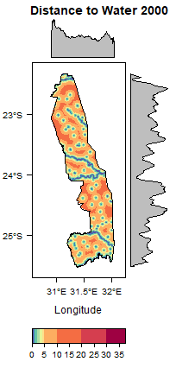
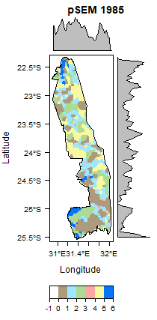
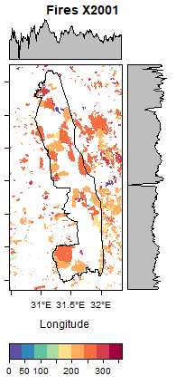
Introduction to Data Cubes
Variables in the context of Biodiversity
Complexity of ecosystems incl. Variability across scales

Slide 21
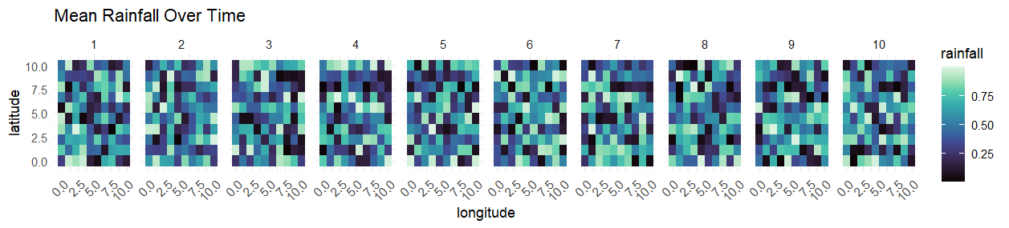
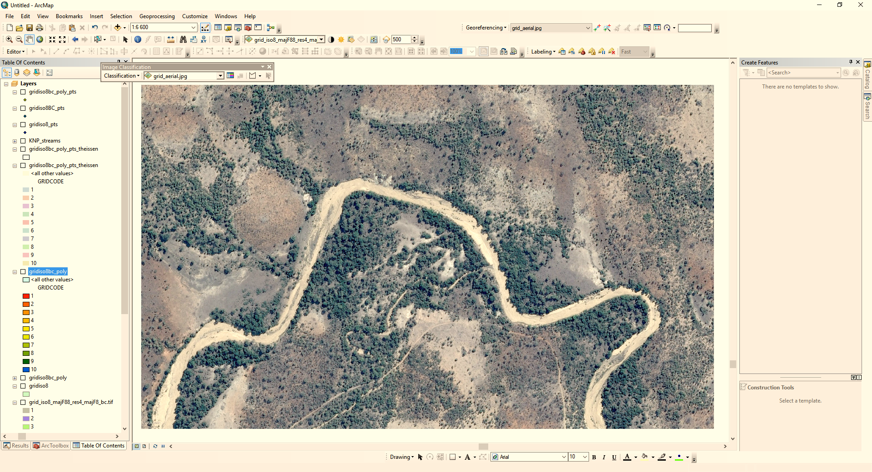
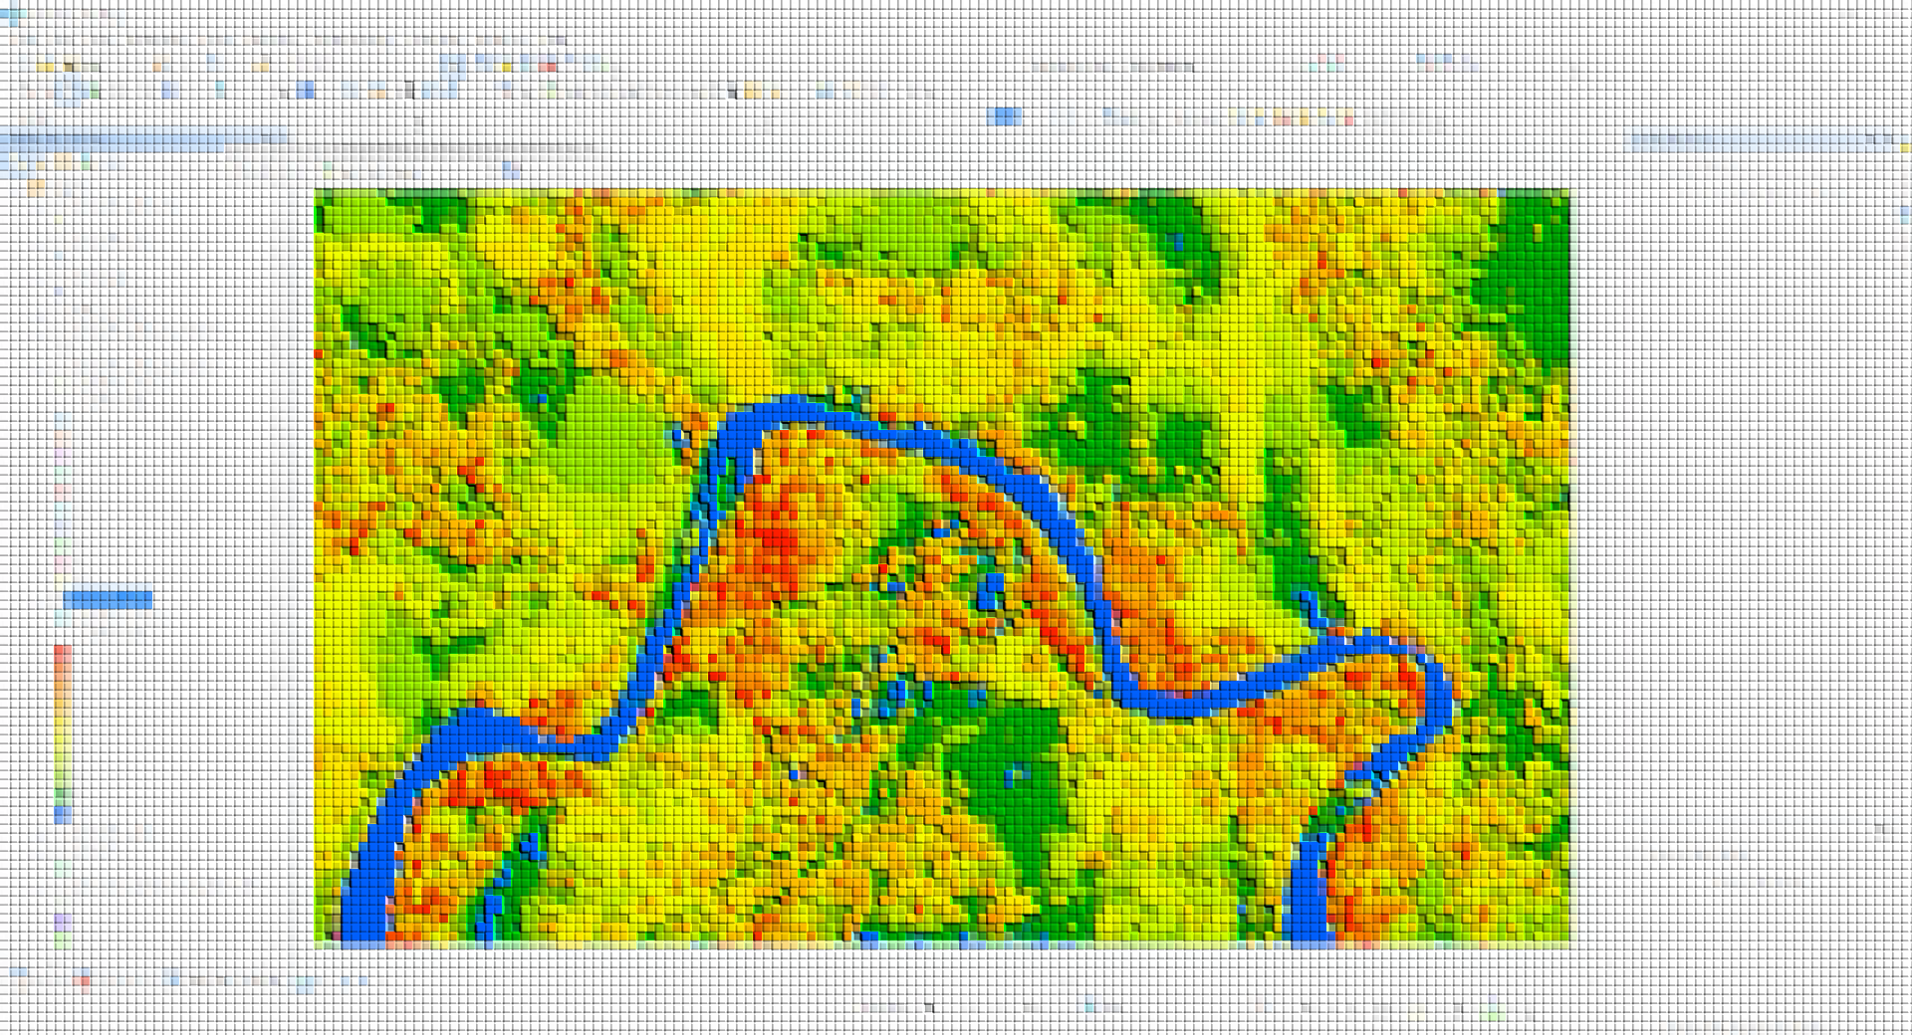
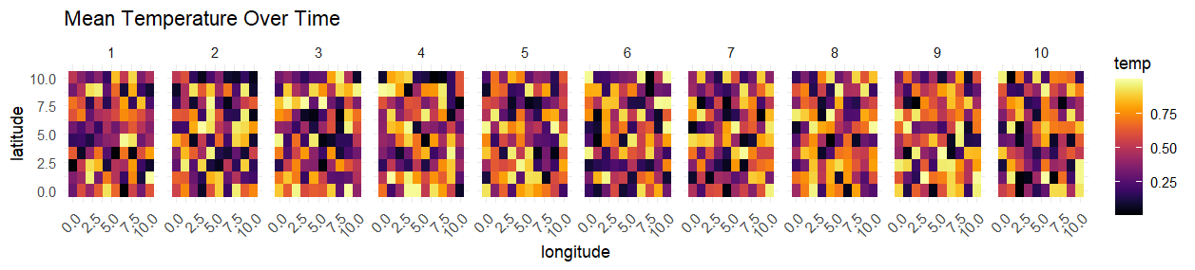
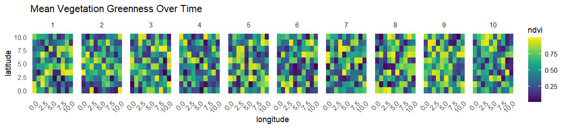
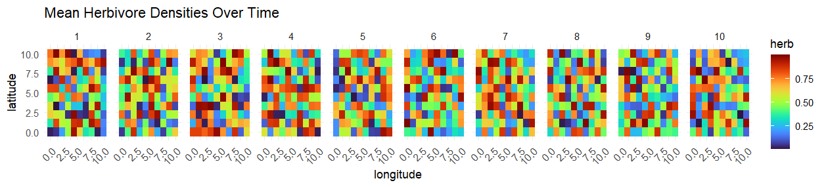
Introduction to Data Cubes
Variables in the context of Biodiversity
Complexity of ecosystems + Variability of Variables across scales
Rainfall
Temp °C
NDVI
Animals

Slide 22
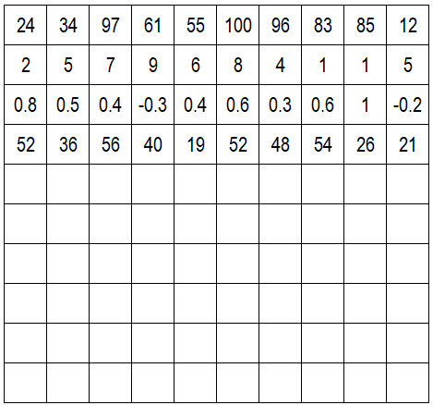
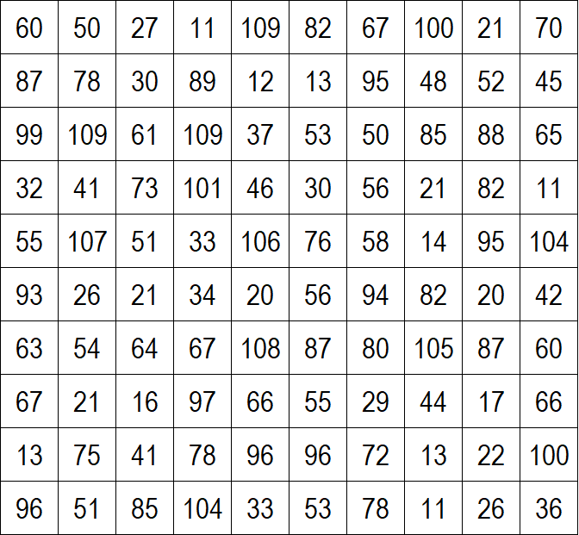
Introduction to Data Cubes
Multidimensional data arrays or matrices
XY matrix of rainfall
Rainfall
Latitude
Longitude

Slide 23
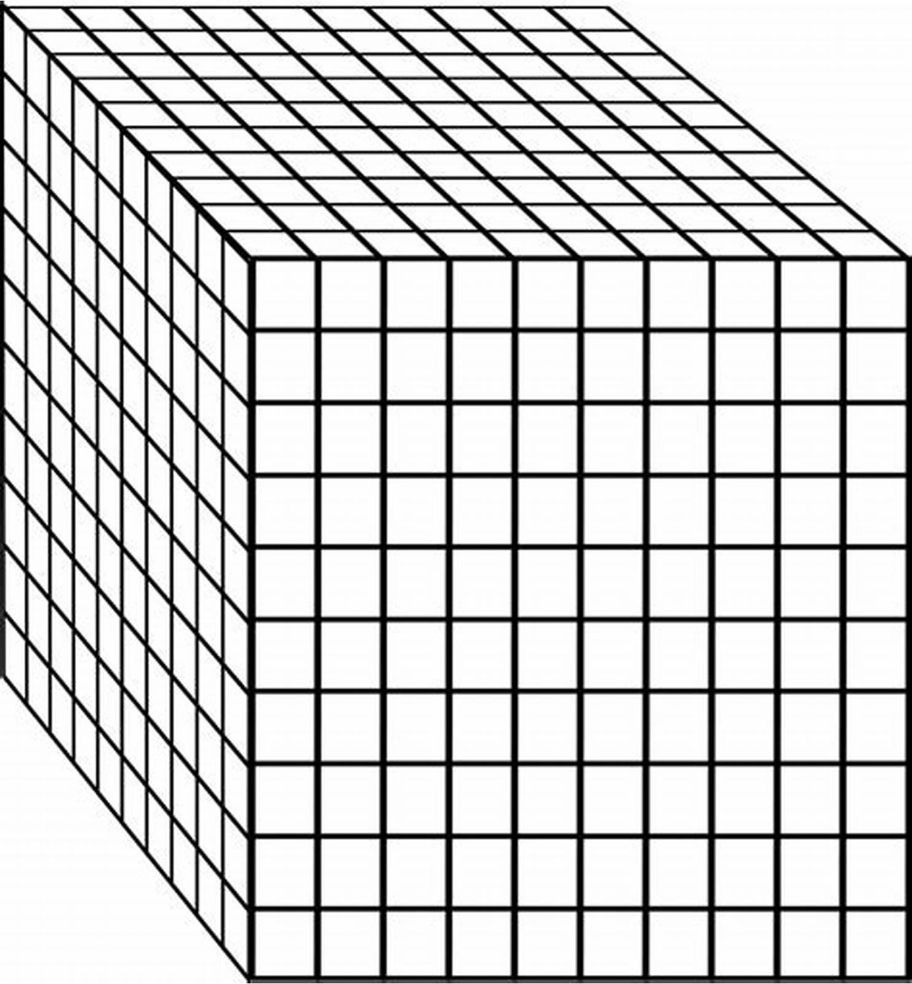
Time | Year
Rainfall
Latitude
Longitude

Slide 24
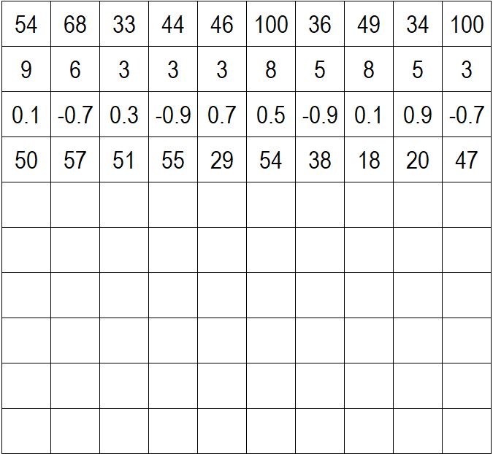
Time | Year
Rainfall
ENVIRO VARIABLES
Latitude
Temperature
Vegetation
Herbivores
Longitude

Slide 25
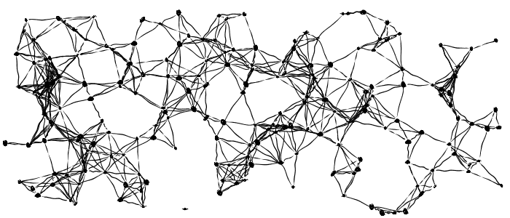
Time | Year
Rainfall
ENVIRO VARIABLES
Latitude
Temperature
Vegetation
Herbivores
Longitude
Notes:
The tricky part comes in when you need to start looking at the interactions between variables and the outcomes.
We must not forget, ecological systems are dynamically complex and adaptive, so understanding these interactions are essential effective biodiversity conservation.

Slide 26
To build a Data Cube we need FAIR Data
Data Cubes from Biodiversity Data
Laying the Foundation to track Change
To track biodiversity and environmental changes across scales we need data.
Quality and utility of analyses & results rely on well-structured, standardised biodiversity data.
To effectively use data cubes for achieving SDGs, data must be FAIR:
  Findable
  Accessible
  Interoperable
  Reusable
Maarten will now introduce key concepts around biodiversity data, including definitions, data standards, and the importance of making data FAIR .
https://doi.org/10.5194/esd-11-201-2020

Slide 27
Biodiversity Data
Definitions, Standards, FAIR

Slide 28
Biodiversity Data
What is Biodiversity Data?
Introduction
Key elements that we will cover:
Sources of Biodiversity Data
Data publication
Biodiversity Data Standards
FAIR data publishing

Slide 29
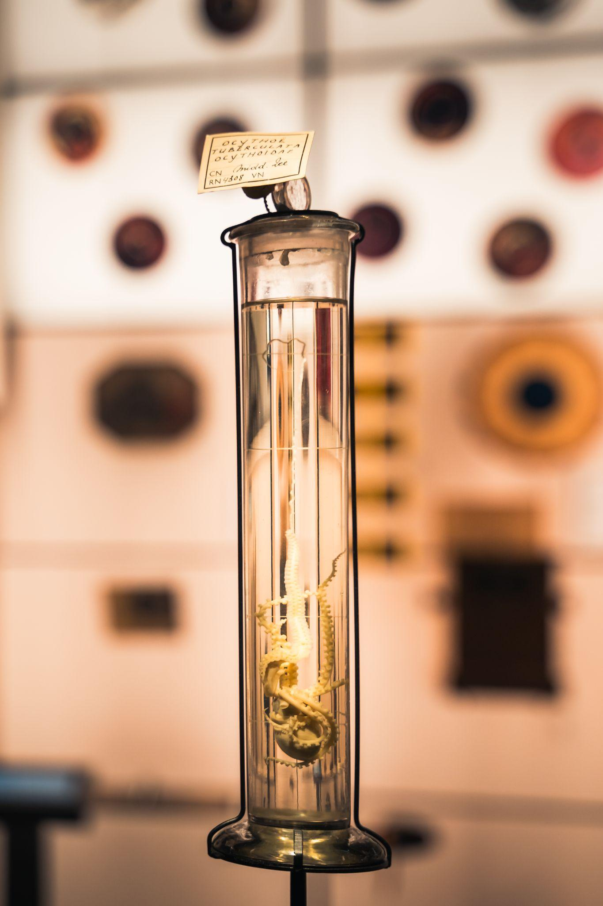

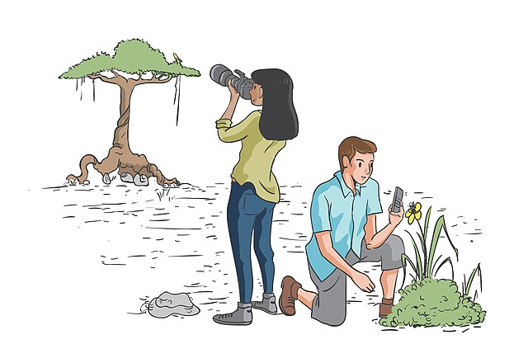
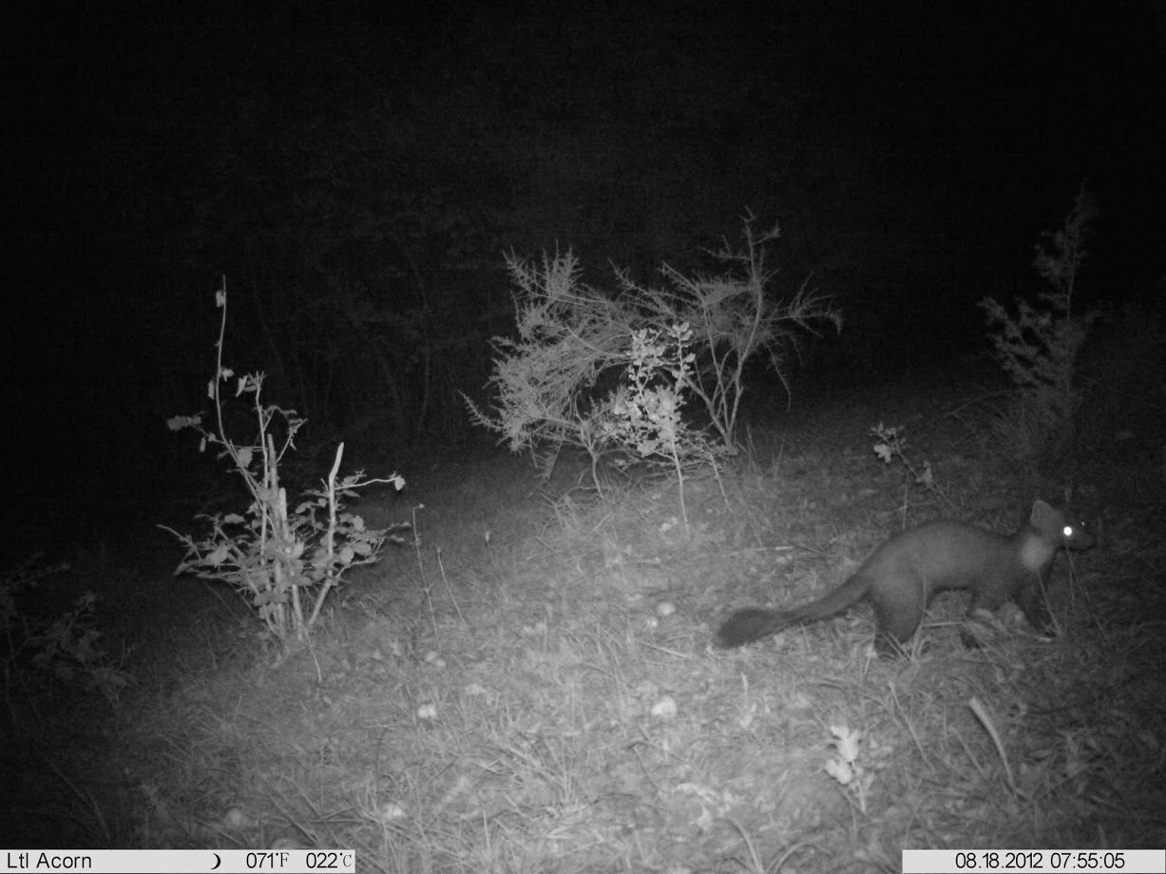

Biodiversity Data
What is Biodiversity Data?
Sources of Biodiversity Data
Checklists
Citizen science
Specimens
Ecological surveys
…
iNaturalist. Available from https://www.inaturalist.org. Accessed Okt 1, 2024.
© Martin Corlazzoli
Hans Hillewaert / CC BY-SA 4.0
CC0 Wikimedia commons (Andrawaag)

Slide 30
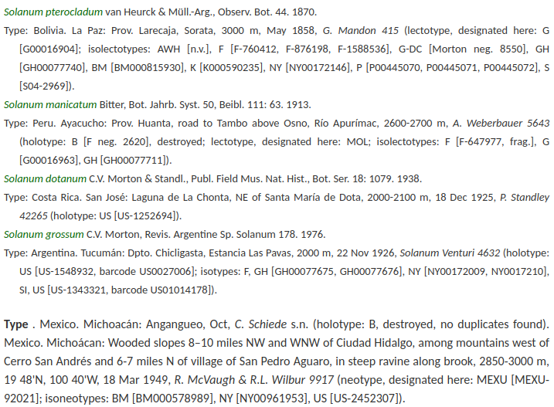

Biodiversity Data
What is Biodiversity Data?
Biodiversity Literature
Plazi. Available from https://plazi.org. Accessed Okt 1, 2024.

Slide 31
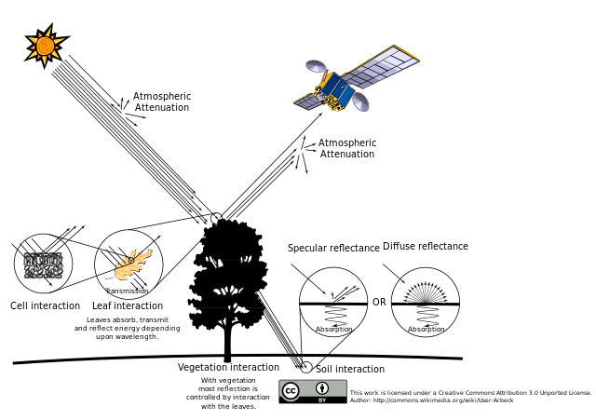
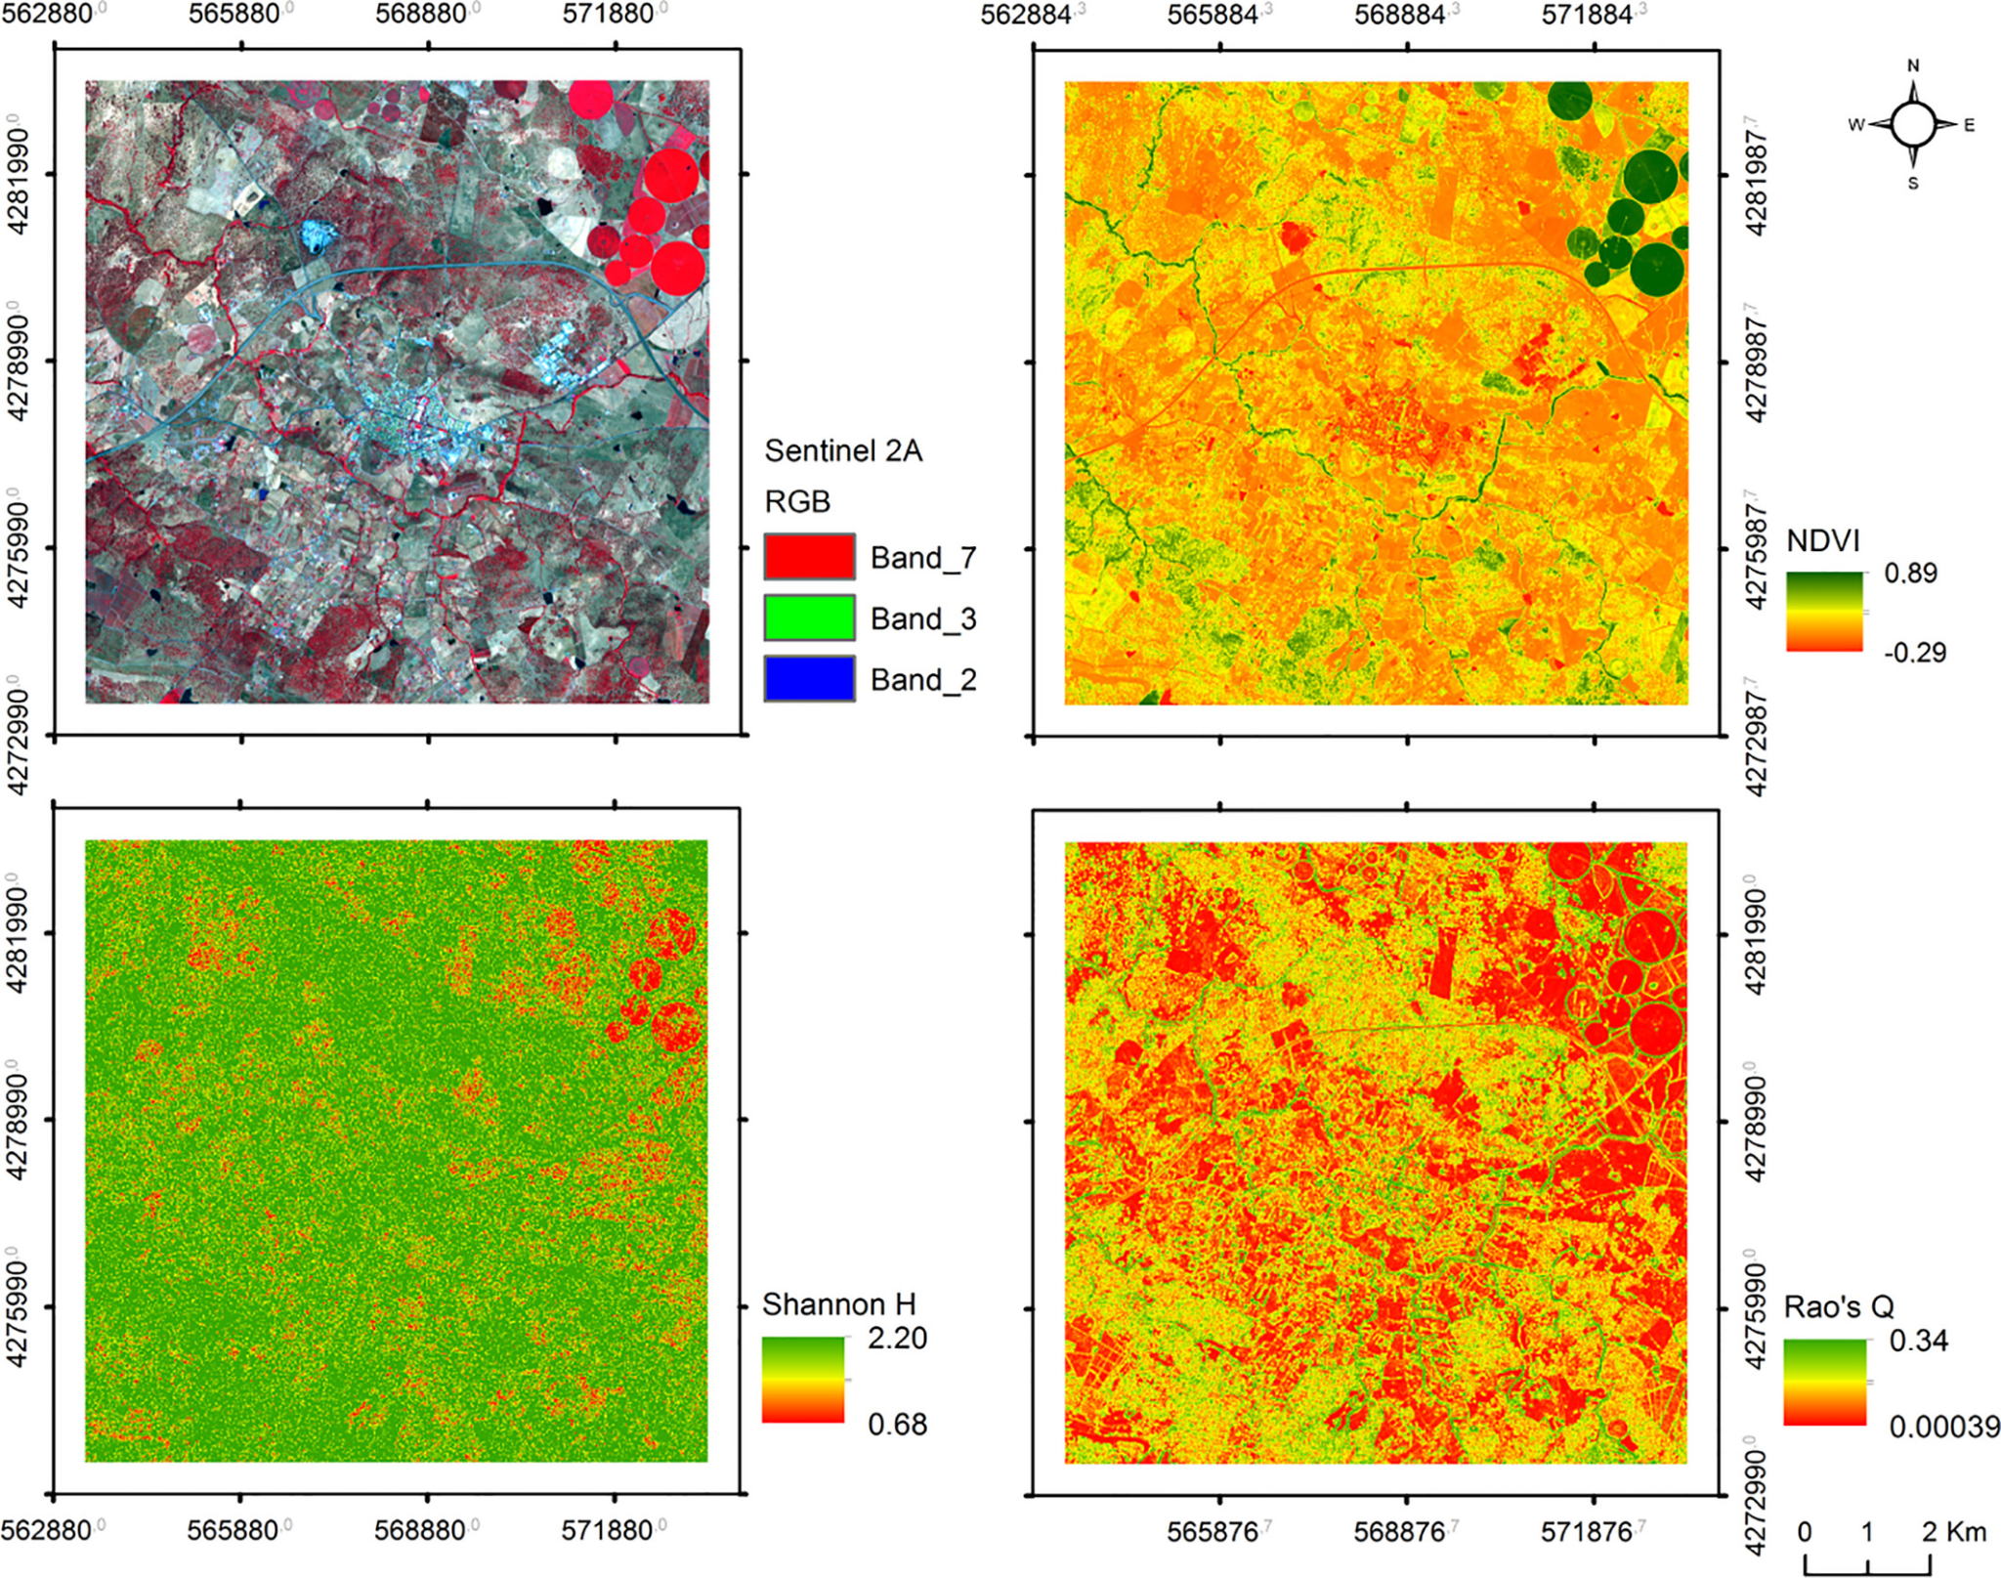
Biodiversity Data
What is Biodiversity Data?
Remote sensing
Rocchini D, Luque S, Pettorelli N, et al. Measuring β-diversity by remote sensing: A challenge for biodiversity monitoring. Methods Ecol Evol. 2018; 9: 1787–1798. https://doi.org/10.1111/2041-210X.12941

Slide 32
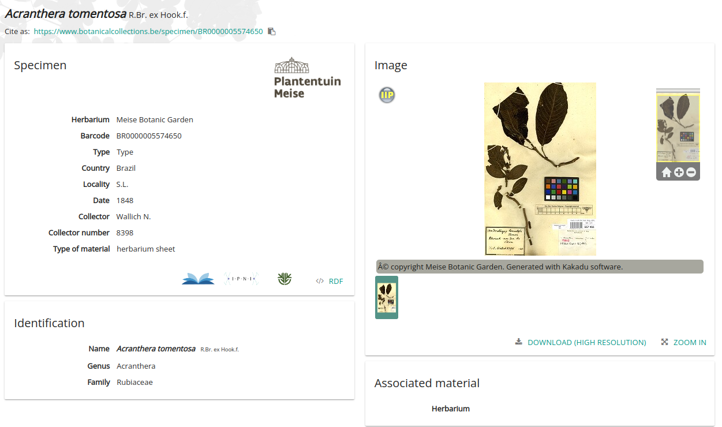
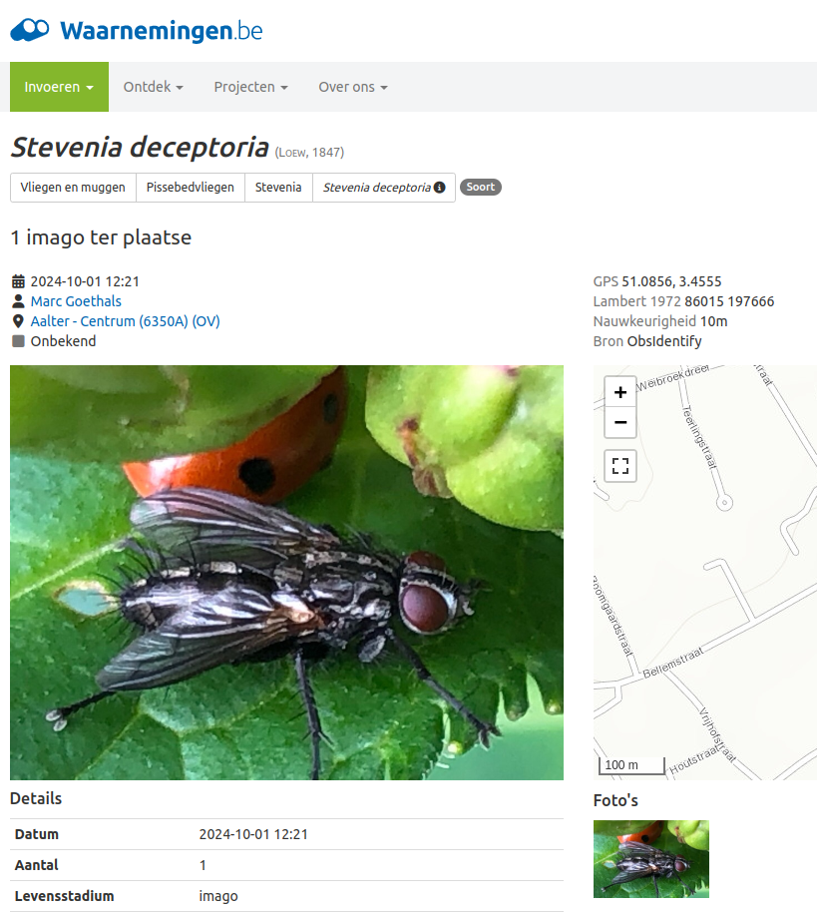
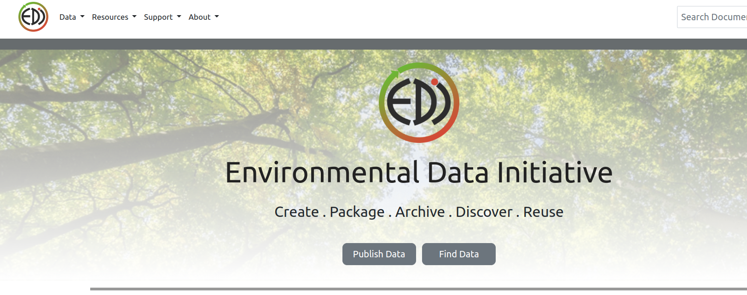
Biodiversity Data
Data publishing
Liberating data

Slide 33
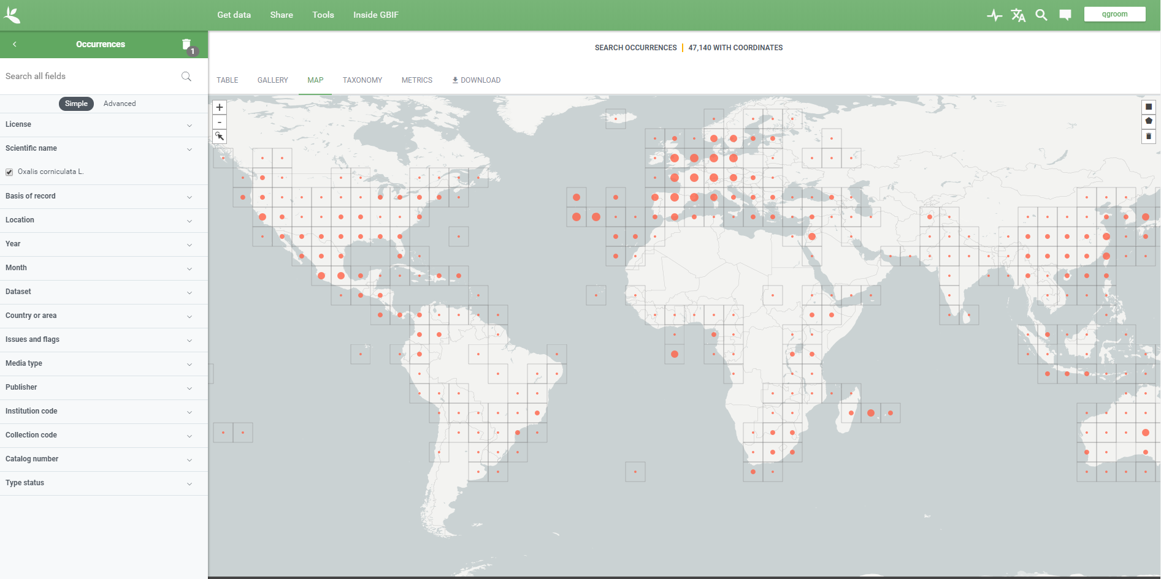

Biodiversity Data
Data publishing and aggregation
Global Biodiversity Information Facility
https://www.gbif.org/

Slide 34

Biodiversity Data
Data Publication
Data usage and tracking
Two papers a day from GBIF mobilized data
Heberling, J. M., Miller, J. T., Noesgaard, D., Weingart, S. B., & Schigel, D. (2021). Data integration enables global biodiversity synthesis. Proceedings of the National Academy of Sciences, 118(6).

Slide 35

Biodiversity Data
https://www.go-fair.org/fair-principles/
FAIR data principles
How do we make sure that this works?

Slide 36


Biodiversity Data
FAIR data principles
Findability

Slide 37
Biodiversity Data
https://www.go-fair.org/fair-principles/
FAIR data principles
How do we make sure that this works?

Slide 38

Biodiversity Data
FAIR data principles
The “I” in FAIR
Community agreed and curated data standards to be able to talk about biodiversity data.

Slide 39



Biodiversity Data
FAIR data principles
Darwin Core (DwC)
http://rs.tdwg.org/dwc/terms/

Slide 40

Biodiversity Data
FAIR data principles
Data mapping
Mapping data to the same terminology

Slide 41
Biodiversity Data
https://www.go-fair.org/fair-principles/
FAIR data principles
How do we make sure that this works?

Slide 42




Biodiversity Data
FAIR data principles
Licensing

Slide 43
Biodiversity Data
FAIR data principles
Licensing: open data
CC0, under which data are made available for any use without restriction or particular requirements on the part of users
CC BY, under which data are made available for any use provided that attribution is appropriately given for the sources of data used, in the manner specified by the owner
CC BY-NC, under which data are made available for any use provided that attribution is appropriately given and provided the use is not for commercial purposes

Slide 44


Biodiversity Data
FAIR data principles
Example dataset on GBIF
https://www.gbif.org/

Slide 45

Biodiversity Data
What’s next?
New developments and sources of data
Encourage the collection and publication of data
Develop better monitoring methods
  Cheaper and more reliable
Improve methods of analysis

Slide 46



Biodiversity Data
What’s next?
Cloud computing for Biodiversity
Leveraging the power of cloud computing

Slide 47

Biodiversity Data
Questions?

Slide 48
Things to prepare for next time
Next lectures are more interactive
Hands-on in next sessions
Setup free online account
  GBIF (https://www.gbif.org/)
    https://www.gbif.org/user/profile and https://www.gbif.org/training
  GEE (https://earthengine.google.com/)
    https://www.youtube.com/watch?v=S0AzoP40cDI
  Google Colab (https://colab.google/)
    https://www.youtube.com/watch?v=qN4WSbpW8-w

Slide 49






END OF DAY 1
Thank you!
b-cubed.eu
@BCubedProject
Maarten Trekels | Sandra MacFadyen
B-Cubed Project
maarten.trekels@plantentuinmeise.be | macfadyen@sun.ac.za
B-Cubed
Newsletter
This project receives funding from the European Union’s Horizon Europe Research and Innovation Programme
(ID No 101059592). Views and opinions expressed are those of the author(s) only and do not necessarily reflect those of the European Union or the European Commission. Neither the EU nor the EC can be held responsible for them.

